Slide 1
Digital Design & Computer Arch. Lecture 11: Microarchitecture I
Prof. Onur Mutlu
ETH Zürich
Spring 2020
26 March 2020

Slide 2
Readings
This week
Introduction to microarchitecture and single-cycle microarchitecture
H&H, Chapter 7.1-7.3
P&P, Appendices A and C
Multi-cycle microarchitecture
H&H, Chapter 7.4
P&P, Appendices A and C
Next week
Pipelining
H&H, Chapter 7.5
Pipelining Issues
H&H, Chapter 7.8.1-7.8.3

Slide 3
Agenda for Today & Next Few Lectures
Instruction Set Architectures (ISA): LC-3 and MIPS
Assembly programming: LC-3 and MIPS
Microarchitecture (principles & single-cycle uarch)
Multi-cycle microarchitecture
Pipelining
Issues in Pipelining: Control & Data Dependence Handling, State Maintenance and Recovery, …
Out-of-Order Execution

Slide 4
Recall: The Von Neumann Model
MEMORY
Mem Addr Reg
Mem Data Reg
INPUT
Keyboard,
Mouse,
Disk…
PROCESSING UNIT
OUTPUT
Monitor,
Printer,
Disk…
ALU
TEMP
CONTROL UNIT
PC or IP
Inst Register

Slide 5
Recall: LC-3: A Von Neumann Machine

Slide 6
Recall: The Instruction Cycle
FETCH
DECODE
EVALUATE ADDRESS
FETCH OPERANDS
EXECUTE
STORE RESULT

Slide 7
Recall: The Instruction Set Architecture
The ISA is the interface between what the software commands and what the hardware carries out
The ISA specifies
The memory organization
Address space (LC-3: 2¹⁶, MIPS: 2³²)
Addressability (LC-3: 16 bits, MIPS: 32 bits)
Word- or Byte-addressable
The register set
R0 to R7 in LC-3
32 registers in MIPS
The instruction set
Opcodes
Data types
Addressing modes
Semantics of instructions
Problem
Algorithm
Program
ISA
Microarchitecture
Circuits
Electrons

Slide 8
Microarchitecture
An implementation of the ISA
How do we implement the ISA?
We will discuss this for many lectures
There can be many implementations of the same ISA
MIPS R2000, R10000, …
Intel 80486, Pentium, Pentium Pro, Pentium 4, Kaby Lake, Coffee Lake, … AMD K5, K7, K9, Bulldozer, BobCat, …

Slide 9
(A Bit More on) ISA Design and Tradeoffs

Slide 10
The Von Neumann Model/Architecture
Von Neumann model is also called stored program computer (instructions in memory). It has two key properties:
Stored program
Instructions stored in a linear memory array
Memory is unified between instructions and data
The interpretation of a stored value depends on the control signals
Sequential instruction processing
One instruction processed (fetched, executed, completed) at a time
Program counter (instruction pointer) identifies the current instruction
Program counter is advanced sequentially except for control transfer instructions
When is a value interpreted as an instruction?

Slide 11
The Von Neumann Model/Architecture
Recommended reading
Burks, Goldstein, von Neumann, “Preliminary discussion of the logical design of an electronic computing instrument,” 1946.
Required reading
Patt and Patel book, Chapter 4, “The von Neumann Model”
Stored program
Sequential instruction processing

Slide 12
The Von Neumann Model (of a Computer)
MEMORY
Mem Addr Reg
Mem Data Reg
PROCESSING UNIT
INPUT
OUTPUT
ALU
TEMP
CONTROL UNIT
IP
Inst Register

Slide 13
The Von Neumann Model (of a Computer)
Q: Is this the only way that a computer can operate?
A: No.
Qualified Answer: But, it has been the dominant way
i.e., the dominant paradigm for computing
for N decades

Slide 14
The Dataflow Model (of a Computer)
Von Neumann model: An instruction is fetched and executed in control flow order
As specified by the instruction pointer
Sequential unless explicit control flow instruction
Dataflow model: An instruction is fetched and executed in data flow order
i.e., when its operands are ready
i.e., there is no instruction pointer
Instruction ordering specified by data flow dependence
Each instruction specifies “who” should receive the result
An instruction can “fire” whenever all operands are received
Potentially many instructions can execute at the same time
Inherently more parallel

Slide 15
Von Neumann vs Dataflow
Consider a Von Neumann program
What is the significance of the program order?
What is the significance of the storage locations?
Which model is more natural to you as a programmer?
a
b
v <= a + b;
w <= b * 2;
x <= v - w
y <= v + w
z <= x * y
+
*2
-
+
Sequential
*
Dataflow
z

Slide 16
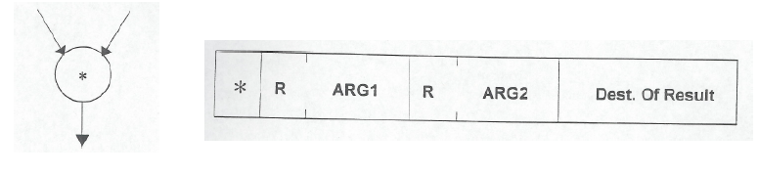
More on Data Flow
In a data flow machine, a program consists of data flow nodes
A data flow node fires (fetched and executed) when all it inputs are ready
i.e. when all inputs have tokens
Data flow node and its ISA representation

Slide 17
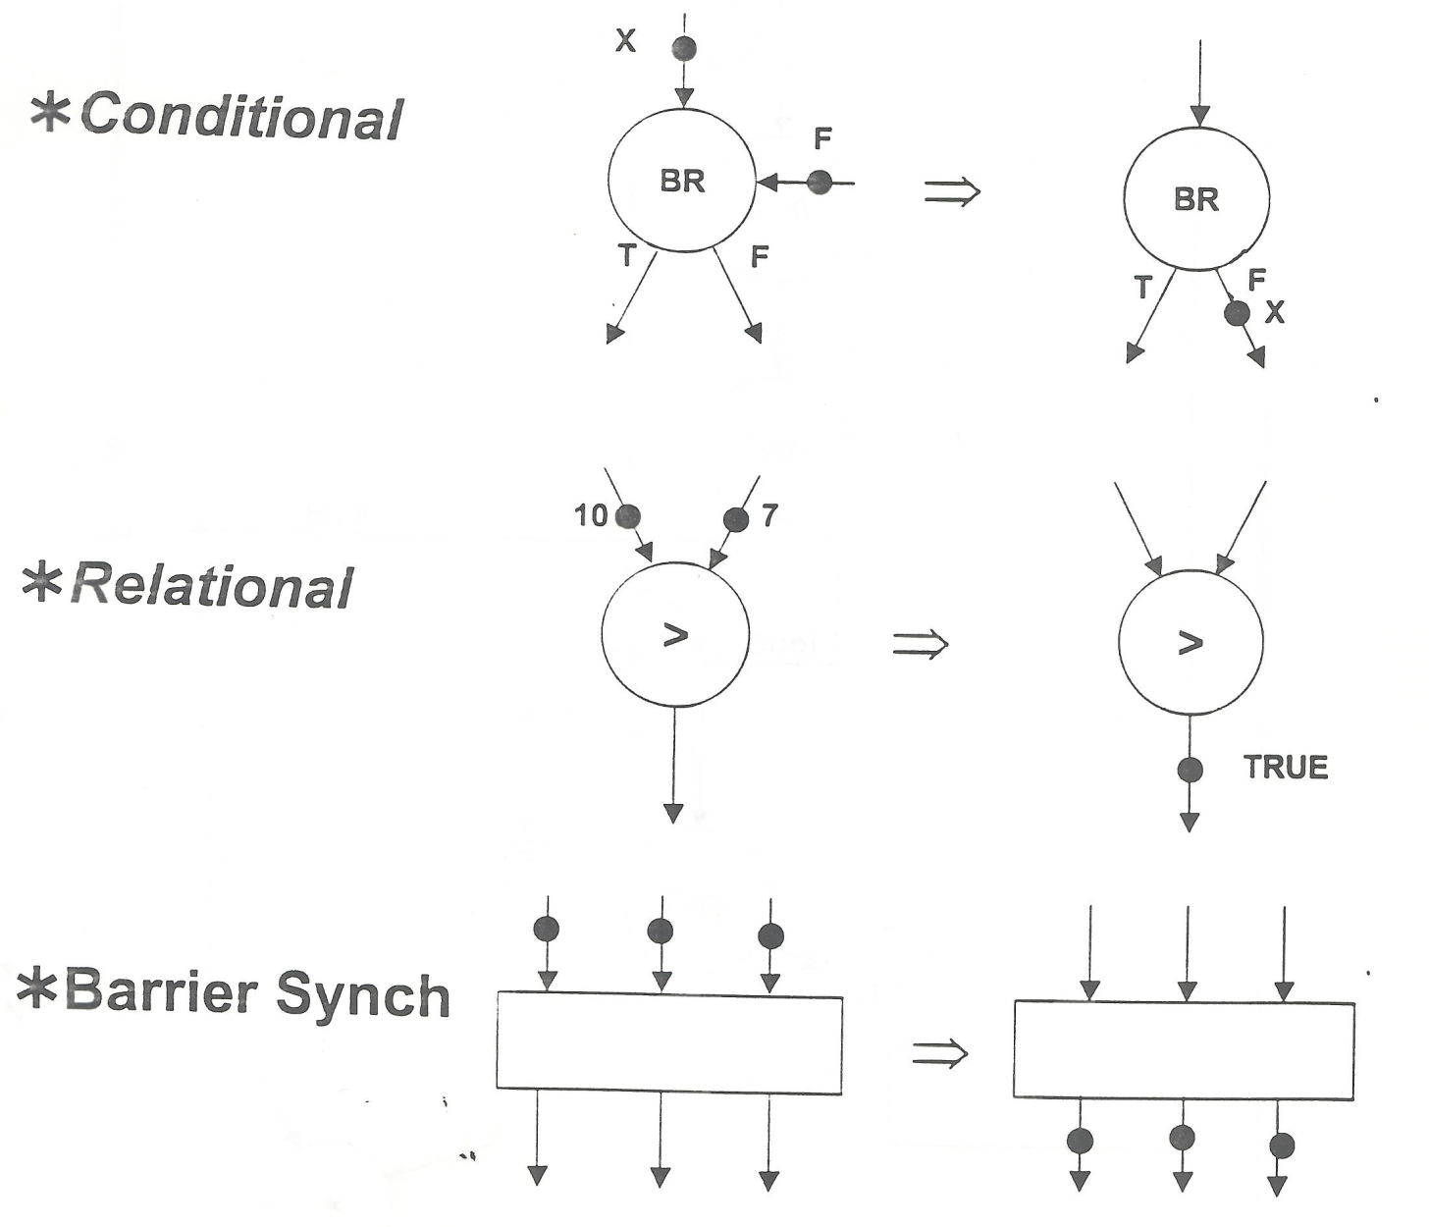
Data Flow Nodes

Slide 18
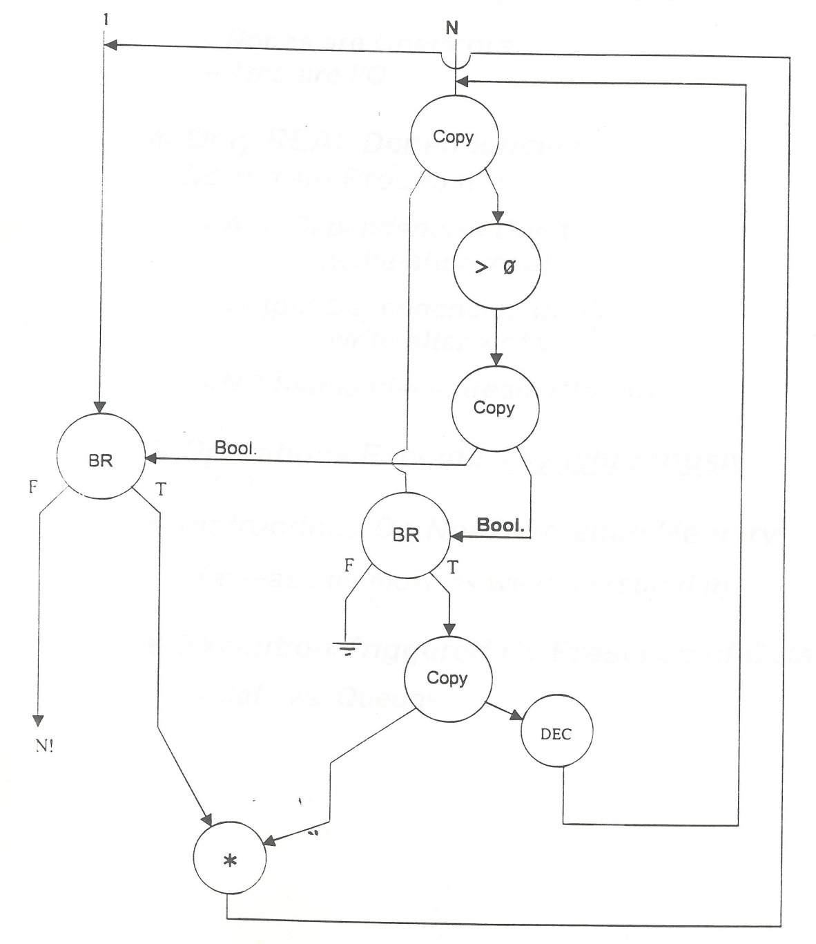
An Example Data Flow Program
OUT

Slide 19
ISA-level Tradeoff: Instruction Pointer
Do we need an instruction pointer in the ISA?
Yes: Control-driven, sequential execution
An instruction is executed when the IP points to it
IP automatically changes sequentially (except for control flow instructions)
No: Data-driven, parallel execution
An instruction is executed when all its operand values are available (data flow)
Tradeoffs: MANY high-level ones
Ease of programming (for average programmers)?
Ease of compilation?
Performance: Extraction of parallelism?
Hardware complexity?

Slide 20
ISA vs. Microarchitecture Level Tradeoff
A similar tradeoff (control vs. data-driven execution) can be made at the microarchitecture level
ISA: Specifies how the programmer sees the instructions to be executed
Programmer sees a sequential, control-flow execution order vs.
Programmer sees a data-flow execution order
Microarchitecture: How the underlying implementation actually executes instructions
Microarchitecture can execute instructions in any order as long as it obeys the semantics specified by the ISA when making the instruction results visible to software
Programmer should see the order specified by the ISA

Slide 21
Let’s Get Back to the Von Neumann Model
But, if you want to learn more about dataflow…
Dennis and Misunas, “A preliminary architecture for a basic data-flow processor,” ISCA 1974.
Gurd et al., “The Manchester prototype dataflow computer,” CACM 1985.
A later lecture
If you are really impatient:
http://www.youtube.com/watch?v=D2uue7izU2c
http://www.ece.cmu.edu/~ece740/f13/lib/exe/fetch.php?media=onur-740-fall13-module5.2.1-dataflow-part1.ppt

Slide 22
The Von-Neumann Model
All major instruction set architectures today use this model
x86, ARM, MIPS, SPARC, Alpha, POWER, RISC-V, …
Underneath (at the microarchitecture level), the execution model of almost all implementations (or, microarchitectures) is very different
Pipelined instruction execution: Intel 80486 uarch
Multiple instructions at a time: Intel Pentium uarch
Out-of-order execution: Intel Pentium Pro uarch
Separate instruction and data caches
But, what happens underneath that is not consistent with the von Neumann model is not exposed to software
Difference between ISA and microarchitecture

Slide 23
What is Computer Architecture?
ISA+implementation definition: The science and art of designing, selecting, and interconnecting hardware components and designing the hardware/software interface to create a computing system that meets functional, performance, energy consumption, cost, and other specific goals.
Traditional (ISA-only) definition: “The term architecture is used here to describe the attributes of a system as seen by the programmer, i.e., the conceptual structure and functional behavior as distinct from the organization of the dataflow and controls, the logic design, and the physical implementation.” Gene Amdahl, IBM Journal of R&D, April 1964

Slide 24
ISA vs. Microarchitecture
ISA
Agreed upon interface between software and hardware
SW/compiler assumes, HW promises
What the software writer needs to know to write and debug system/user programs
Microarchitecture
Specific implementation of an ISA
Not visible to the software
Microprocessor
ISA, uarch, circuits
“Architecture” = ISA + microarchitecture
Problem
Algorithm
Program
ISA
Microarchitecture
Circuits
Electrons
Notes:
ISA is the interface between hardware and software… It is a contract that the hardware promises to satisfy.
Builder/user interface

Slide 25
ISA vs. Microarchitecture
What is part of ISA vs. Uarch?
Gas pedal: interface for “acceleration”
Internals of the engine: implement “acceleration”
Implementation (uarch) can be various as long as it satisfies the specification (ISA)
Add instruction vs. Adder implementation
Bit serial, ripple carry, carry lookahead adders are all part of microarchitecture (see H&H Chapter 5.2.1)
x86 ISA has many implementations: 286, 386, 486, Pentium, Pentium Pro, Pentium 4, Core, Kaby Lake, Coffee Lake, …
Microarchitecture usually changes faster than ISA
Few ISAs (x86, ARM, SPARC, MIPS, Alpha, RISC-V) but many uarchs
Why?

Slide 26
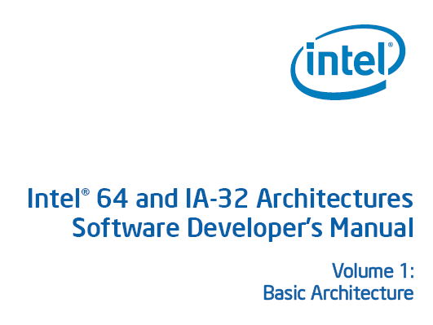
ISA
Instructions
Opcodes, Addressing Modes, Data Types
Instruction Types and Formats
Registers, Condition Codes
Memory
Address space, Addressability, Alignment
Virtual memory management
Call, Interrupt/Exception Handling
Access Control, Priority/Privilege
I/O: memory-mapped vs. instr.
Task/thread Management
Power and Thermal Management
Multi-threading support, Multiprocessor support
…

Slide 27
Microarchitecture
Implementation of the ISA under specific design constraints and goals
Anything done in hardware without exposure to software
Pipelining
In-order versus out-of-order instruction execution
Memory access scheduling policy
Speculative execution
Superscalar processing (multiple instruction issue?)
Clock gating
Caching? Levels, size, associativity, replacement policy
Prefetching?
Voltage/frequency scaling?
Error correction?

Slide 28
Property of ISA vs. Uarch?
ADD instruction’s opcode
Bit-serial adder vs. Ripple-carry adder
Number of general purpose registers
Number of cycles to execute the MUL instruction
Number of ports to the register file
Whether or not the machine employs pipelined instruction execution
Remember
Microarchitecture: Implementation of the ISA under specific design constraints and goals

Slide 29
Design Point
A set of design considerations and their importance
leads to tradeoffs in both ISA and uarch
Example considerations:
Cost
Performance
Maximum power consumption, thermal
Energy consumption (battery life)
Availability
Reliability and Correctness
Time to Market
Security, safety, predictability, …
Design point determined by the “Problem” space (application space), the intended users/market
Problem
Algorithm
Program
ISA
Microarchitecture
Circuits
Electrons

Slide 30
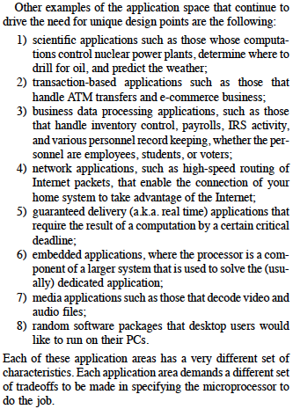
Application Space
Dream, and they will appear…
Patt, “Requirements, bottlenecks,
and good fortune: agents for
microprocessor evolution,”
Proc. of the IEEE 2001.
Many other workloads:
Genome analysis
Machine learning
Robotics
Web search
Graph analytics
…

Slide 31
Increasingly Demanding Applications
Dream
and, they will come
As applications push boundaries, computing platforms will become increasingly strained.

Slide 32
Tradeoffs: Soul of Computer Architecture
ISA-level tradeoffs
Microarchitecture-level tradeoffs
System and Task-level tradeoffs
How to divide the labor between hardware and software
Computer architecture is the science and art of making the appropriate trade-offs to meet a design point
Why art?

Slide 33
Why Is It (Somewhat) Art?
We do not (fully) know the future (applications, users, market)
New demands
from the top
(Look Up)
Problem
Algorithm
Program/Language
User
New demands and
personalities of users
(Look Up)
Runtime System
(VM, OS, MM)
ISA
Microarchitecture
New issues and
capabilities
at the bottom
(Look Down)
Logic
Circuits
Electrons
Notes:
ISA is the interface between hardware and software… It is a contract that the hardware promises to satisfy.

Slide 34
Why Is It (Somewhat) Art?
And, the future is not constant (it changes)!
Changing demands
at the top
(Look Up and Forward)
Problem
Algorithm
Program/Language
User
Changing demands and
personalities of users
(Look Up and Forward)
Runtime System
(VM, OS, MM)
ISA
Microarchitecture
Changing issues and
capabilities
at the bottom
(Look Down and Forward)
Logic
Circuits
Electrons
Notes:
ISA is the interface between hardware and software… It is a contract that the hardware promises to satisfy.

Slide 35
Analogue from Macro-Architecture
Future is not constant in macro-architecture, either
Example: Can a mill be later used as a theater + restaurant + conference room?

Slide 36

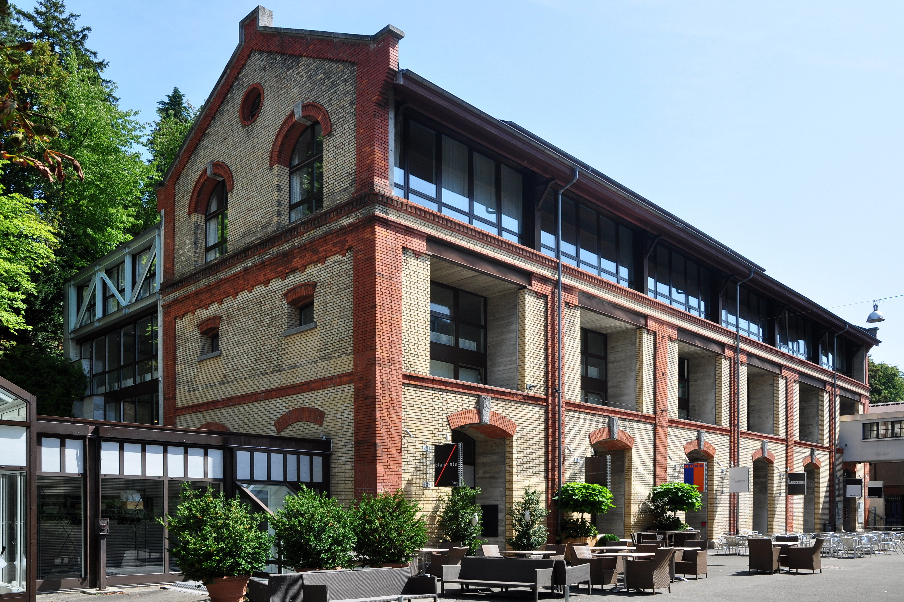
Mühle Tiefenbrunnen
Originally built as a brewery in 1889, part of it was converted into a mill in 1913, and the other part into a cold store
Nowadays is a center for a variety of activities: theater, conferences, restaurants, shops, museum…
Brewery in 1900
http://www.muehle-tiefenbrunnen.ch/

Slide 37
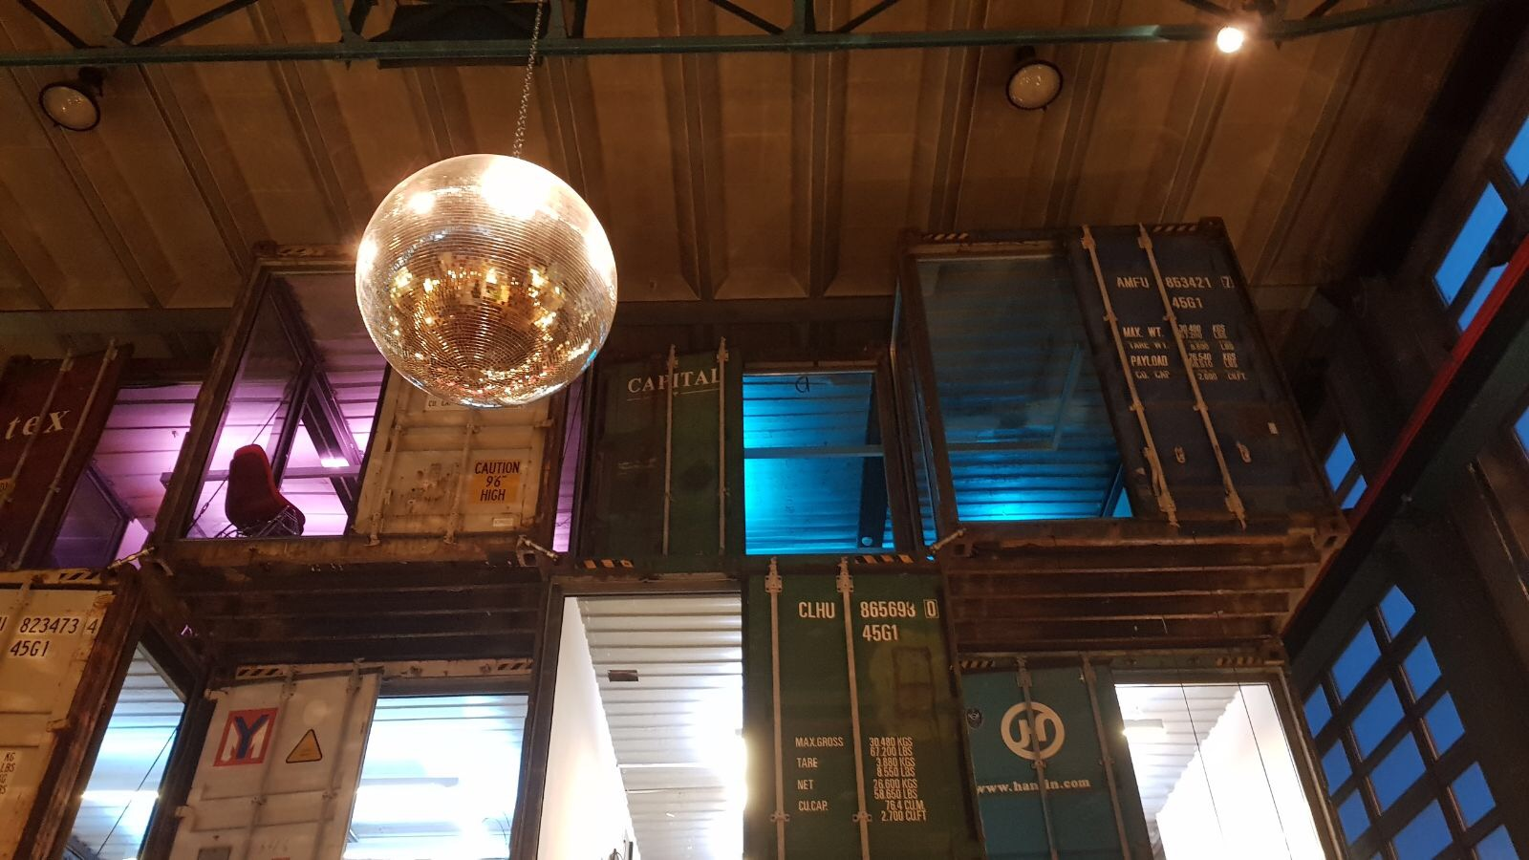
Another Example (I)
Photo credit: Prof. Can Alkan

Slide 38
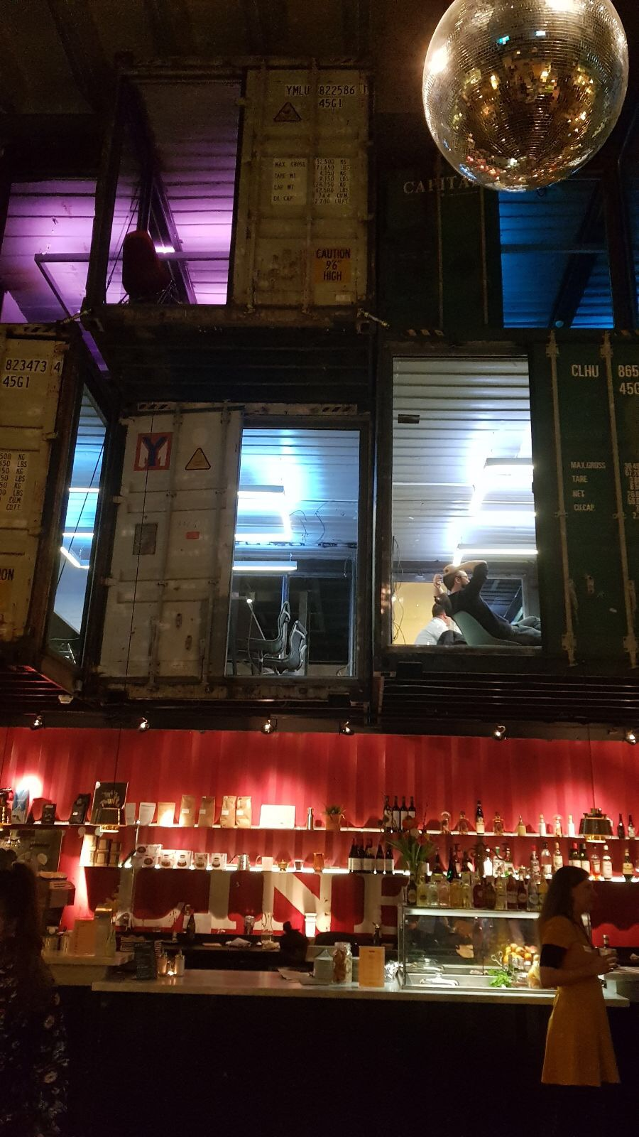
Another Example (II)
Photo credit: Prof. Can Alkan

Slide 39
By Roland zh (Own work) [CC BY-SA 3.0
(https://creativecommons.org/licenses/by-sa/3.0)],
via Wikimedia Commons

Slide 40
Implementing the ISA: Microarchitecture Basics

Slide 41
Now That We Have an ISA
How do we implement it?
i.e., how do we design a system that obeys the hardware/software interface?
Aside: “System” can be solely hardware or a combination of hardware and software
“Translation of ISAs”
A virtual ISA can be converted by “software” into an implementation ISA
We will assume “hardware” implementation for most lectures

Slide 42
How Does a Machine Process Instructions?
What does processing an instruction mean?
We will assume the von Neumann model (for now)
AS = Architectural (programmer visible) state before an instruction is processed
Process instruction
AS’ = Architectural (programmer visible) state after an instruction is processed
Processing an instruction: Transforming AS to AS’ according to the ISA specification of the instruction

Slide 43
The Von Neumann Model/Architecture
Stored program
Sequential instruction processing

Slide 44
Recall: The Von Neumann Model
MEMORY
Mem Addr Reg
Mem Data Reg
INPUT
Keyboard,
Mouse,
Disk…
PROCESSING UNIT
OUTPUT
Monitor,
Printer,
Disk…
ALU
TEMP
CONTROL UNIT
PC or IP
Inst Register

Slide 45
The “Process Instruction” Step
ISA specifies abstractly what AS’ should be, given an instruction and AS
It defines an abstract finite state machine where
State = programmer-visible state
Next-state logic = instruction execution specification
From ISA point of view, there are no “intermediate states” between AS and AS’ during instruction execution
One state transition per instruction
Microarchitecture implements how AS is transformed to AS’
There are many choices in implementation
We can have programmer-invisible state to optimize the speed of instruction execution: multiple state transitions per instruction
Choice 1: AS → AS’ (transform AS to AS’ in a single clock cycle)
Choice 2: AS → AS+MS1 → AS+MS2 → AS+MS3 → AS’ (take multiple clock cycles to transform AS to AS’)

Slide 46
A Very Basic Instruction Processing Engine
Each instruction takes a single clock cycle to execute
Only combinational logic is used to implement instruction execution
No intermediate, programmer-invisible state updates
AS = Architectural (programmer visible) state
at the beginning of a clock cycle
Process instruction in one clock cycle
AS’ = Architectural (programmer visible) state
at the end of a clock cycle

Slide 47
A Very Basic Instruction Processing Engine
Single-cycle machine
What is the clock cycle time determined by?
What is the critical path of the combinational logic determined by?
AS’
AS
Sequential
Logic
(State)
Combinational
Logic

Slide 48
Recall: Programmer Visible (Architectural) State
M[0]
M[1]
M[2]
M[3]
Registers
- given special names in the ISA
(as opposed to addresses)
- general vs. special purpose
M[4]
M[N-1]
Memory
array of storage locations
indexed by an address
Program Counter
memory address
of the current instruction
Instructions (and programs) specify how to transform
the values of programmer visible state

Slide 49
Single-cycle vs. Multi-cycle Machines
Single-cycle machines
Each instruction takes a single clock cycle
All state updates made at the end of an instruction’s execution
Big disadvantage: The slowest instruction determines cycle time → long clock cycle time
Multi-cycle machines
Instruction processing broken into multiple cycles/stages
State updates can be made during an instruction’s execution
Architectural state updates made at the end of an instruction’s execution
Advantage over single-cycle: The slowest “stage” determines cycle time
Both single-cycle and multi-cycle machines literally follow the von Neumann model at the microarchitecture level

Slide 50
Instruction Processing “Cycle”
Instructions are processed under the direction of a “control unit” step by step.
Instruction cycle: Sequence of steps to process an instruction
Fundamentally, there are six steps:
Fetch
Decode
Evaluate Address
Fetch Operands
Execute
Store Result
Not all instructions require all six steps (see P&P Ch. 4)

Slide 51
Recall: The Instruction Processing “Cycle”
FETCH
DECODE
EVALUATE ADDRESS
FETCH OPERANDS
EXECUTE
STORE RESULT

Slide 52
Instruction Processing “Cycle” vs. Machine Clock Cycle
Single-cycle machine:
All six phases of the instruction processing cycle take a single machine clock cycle to complete
Multi-cycle machine:
All six phases of the instruction processing cycle can take multiple machine clock cycles to complete
In fact, each phase can take multiple clock cycles to complete

Slide 53
Instruction Processing Viewed Another Way
Instructions transform Data (AS) to Data’ (AS’)
This transformation is done by functional units
Units that “operate” on data
These units need to be told what to do to the data
An instruction processing engine consists of two components
Datapath: Consists of hardware elements that deal with and transform data signals
functional units that operate on data
hardware structures (e.g. wires and muxes) that enable the flow of data into the functional units and registers
storage units that store data (e.g., registers)
Control logic: Consists of hardware elements that determine control signals, i.e., signals that specify what the datapath elements should do to the data

Slide 54
Single-cycle vs. Multi-cycle: Control & Data
Single-cycle machine:
Control signals are generated in the same clock cycle as the one during which data signals are operated on
Everything related to an instruction happens in one clock cycle (serialized processing)
Multi-cycle machine:
Control signals needed in the next cycle can be generated in the current cycle
Latency of control processing can be overlapped with latency of datapath operation (more parallelism)
See P&P Appendix C for more (microprogrammed multi-cycle microarchitecture)

Slide 55
Many Ways of Datapath and Control Design
There are many ways of designing the data path and control logic
Single-cycle, multi-cycle, pipelined datapath and control
Single-bus vs. multi-bus datapaths
Hardwired/combinational vs. microcoded/microprogrammed control
Control signals generated by combinational logic versus
Control signals stored in a memory structure
Control signals and structure depend on the datapath design

Slide 56
Flash-Forward: Performance Analysis
Execution time of an instruction
{CPI} x {clock cycle time}
Execution time of a program
Sum over all instructions [{CPI} x {clock cycle time}]
{# of instructions} x {Average CPI} x {clock cycle time}
Single-cycle microarchitecture performance
CPI = 1
Clock cycle time = long
Multi-cycle microarchitecture performance
CPI = different for each instruction
Average CPI → hopefully small
Clock cycle time = short
Here, we have
two degrees of freedom
to optimize independently

Slide 57
A Single-Cycle Microarchitecture A Closer Look

Slide 58
Remember…
Single-cycle machine
AS’
AS
Sequential
Logic
(State)
Combinational
Logic

Slide 59
Let’s Start with the State Elements
Data and control inputs
**Based on original figure from [P&H CO&D, COPYRIGHT 2004 Elsevier. ALL RIGHTS RESERVED.]

Slide 60
MIPS State Elements
Program counter:
32-bit register
Instruction memory:
Takes input 32-bit address A and reads the 32-bit data (i.e., instruction) from that address to the read data output RD.
Register file:
The 32-element, 32-bit register file has 2 read ports and 1 write port
Data memory:
Has a single read/write port. If the write enable, WE, is 1, it writes data WD into address A on the rising edge of the clock. If the write enable is 0, it reads address A onto RD.
This notation is used in H&H single-cycle MIPS implementation (H&H Chapter 7.3)

Slide 61
For Now, We Will Assume
“Magic” memory and register file
Combinational read
output of the read data port is a combinational function of the register file contents and the corresponding read select port
Synchronous write
the selected register is updated on the positive edge clock transition when write enable is asserted
Cannot affect read output in between clock edges
Single-cycle, synchronous memory
Contrast this with memory that tells when the data is ready
i.e., Ready bit: indicating the read or write is done
See P&P Appendix C (LC3-b) for multi-cycle memory

Slide 62
Instruction Processing
5 generic steps (P&H book)
Instruction fetch (IF)
Instruction decode and register operand fetch (ID/RF)
Execute/Evaluate memory address (EX/AG)
Memory operand fetch (MEM)
Store/writeback result (WB)
WB
IF
ID/RF
EX/AG
MEM
**Based on original figure from [P&H CO&D, COPYRIGHT 2004 Elsevier. ALL RIGHTS RESERVED.]

Slide 63
What Is To Come: The Full MIPS Datapath
PCSrc₁=Jump
PCSrc₂=Br Taken
bcond
ALU operation
**Based on original figure from [P&H CO&D, COPYRIGHT 2004 Elsevier. ALL RIGHTS RESERVED.]
JAL, JR, JALR omitted

Slide 64
Another Complete Single-Cycle Processor
Single-cycle processor. Harris and Harris, Chapter 7.3.

Slide 65
Single-Cycle Datapath for Arithmetic and Logical Instructions

Slide 66
R-Type ALU Instructions
R-type: 3 register operands
Semantics
MIPS assembly (e.g., register-register signed addition)
add $s0, $s1, $s2 #$s0=rd, $s1=rs, $s2=rt
Machine Encoding
0
rs
rt
rd
0
add (32)
R-Type
6 bits
5 bits
5 bits
5 bits
5 bits
6 bits
if MEM[PC] == add rd rs rt
GPR[rd] ← GPR[rs] + GPR[rt]
PC ← PC + 4

Slide 67
(R-Type) ALU Datapath
25:21
20:16
15:11
1
IF
ID
EX
MEM
WB
if MEM[PC] == ADD rd rs rt
GPR[rd] ← GPR[rs] + GPR[rt]
PC ← PC + 4
Combinational
state update logic
**Based on original figure from [P&H CO&D, COPYRIGHT 2004 Elsevier. ALL RIGHTS RESERVED.]
**Based on original figure from [P&H CO&D, COPYRIGHT 2004 Elsevier. ALL RIGHTS RESERVED.]

Slide 68
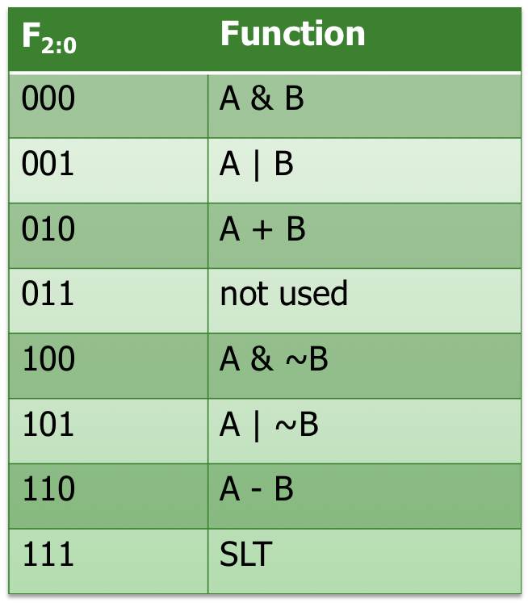
Example: ALU Design
ALU operation (F_{2:0}) comes from the control logic

Slide 69
I-Type ALU Instructions
I-type: 2 register operands and 1 immediate
Semantics
MIPS assembly (e.g., register-immediate signed addition)
addi $s0, $s1, 5 #$s0=rt, $s1=rs
Machine Encoding
addi (0)
rs
rt
immediate
I-Type
6 bits
5 bits
5 bits
16 bits
if MEM[PC] == addi rs rt immediate
PC ← PC + 4
GPR[rt] ← GPR[rs] + sign-extend(immediate)

Slide 70
Datapath for R and I-Type ALU Insts.
25:21
20:16
15:11
RegDest
isItype
1
ALUSrc
isItype
IF
ID
EX
MEM
WB
if MEM[PC] == ADDI rt rs immediate
GPR[rt] ← GPR[rs] + sign-extend (immediate)
PC ← PC + 4
Combinational
state update logic
**Based on original figure from [P&H CO&D, COPYRIGHT 2004 Elsevier. ALL RIGHTS RESERVED.]

Slide 71
Recall: ADD with one Literal in LC-3
ADD assembly and machine code
LC-3 assembly
Register file
ADD R1, R4, #-2
DR
Instruction register
Field Values
SR
OP
DR
SR
imm5
Sign-extend
1
1
4
1
-2
Machine Code
OP
DR
SR
imm5
From FSM
0 0 0 1
0 0 1
1 0 0
1
1 1 1 1 0
15
12
11
9
8
6
5
4
0

Slide 72
Single-Cycle Datapath for Data Movement Instructions

Slide 73
Load Instructions
Load 4-byte word
Semantics
MIPS assembly
lw $s3, 8($s0) #$s0=rs, $s3=rt
Machine Encoding
op
rs=base
rt
imm=offset
I-Type
lw (35)
base
rt
offset
31
26
25
21
20
16
15
0
if MEM[PC] == lw rt offset₁₆ (base)
PC ← PC + 4
EA = sign-extend(offset) + GPR(base)
GPR[rt] ← MEM[ translate(EA) ]

Slide 74
LW Datapath
0
add
RegDest
isItype
1
ALUSrc
isItype
1
if MEM[PC]==LW rt offset₁₆ (base)
EA = sign-extend(offset) + GPR[base]
GPR[rt] ← MEM[ translate(EA) ]
PC ← PC + 4
IF
ID
EX
MEM
WB
Combinational
state update logic

Slide 75
Store Instructions
Store 4-byte word
Semantics
MIPS assembly
sw $s3, 8($s0) #$s0=rs, $s3=rt
Machine Encoding
op
rs=base
rt
imm=offset
sw (43)
base
rt
offset
I-Type
31
26
25
21
20
16
15
0
if Mem[PC] == sw rt offset₁₆ (base)
PC ← PC + 4
EA = sign-extend(offset) + GPR(base)
MEM[ translate(EA) ] ← GPR[rt]

Slide 76
SW Datapath
1
add
RegDest
isItype
0
ALUSrc
isItype
0
if MEM[PC]==SW rt offset₁₆ (base)
EA = sign-extend(offset) + GPR[base]
MEM[ translate(EA) ] ← GPR[rt]
PC ← PC + 4
IF
ID
EX
MEM
WB
Combinational
state update logic

Slide 77
Load-Store Datapath
add
isStore
RegDest
isItype
!isStore
ALUSrc
isItype
isLoad
**Based on original figure from [P&H CO&D, COPYRIGHT 2004 Elsevier. ALL RIGHTS RESERVED.]

Slide 78
Datapath for Non-Control-Flow Insts.
isStore
RegDest
isItype
!isStore
ALUSrc
isItype
isLoad
MemtoReg
isLoad
**Based on original figure from [P&H CO&D, COPYRIGHT 2004 Elsevier. ALL RIGHTS RESERVED.]

Slide 79
Single-Cycle Datapath for Control Flow Instructions

Slide 80
Jump Instruction
Unconditional branch or jump
2 = opcode
immediate (target) = target address
Semantics
if MEM[PC]== j immediate₂₆
target = { PC ✝[31:28], immediate₂₆, 2’b00 }
PC ← target
j target
j (2)
immediate
J-Type
6 bits
26 bits
✝This is the incremented PC
Notes:
jr is R-Type

Slide 81
Unconditional Jump Datapath
isJ
PCSrc
X
0
concat
?
0
ALUSrc
X
0
**Based on original figure from [P&H CO&D, COPYRIGHT 2004 Elsevier. ALL RIGHTS RESERVED.]
if MEM[PC]==J immediate26
PC = { PC[31:28], immediate26, 2’b00 }
What about JR, JAL, JALR?

Slide 82
Other Jumps in MIPS
jal: jump and link (function calls)
Semantics
if MEM[PC]== jal immediate₂₆
$ra ← PC + 4
target = { PC ✝[31:28], immediate₂₆, 2’b00 }
PC ← target
jr: jump register
Semantics
if MEM[PC]== jr rs
PC ← GPR(rs)
jalr: jump and link register
Semantics
if MEM[PC]== jalr rs
$ra ← PC + 4
PC ← GPR(rs)
✝This is the incremented PC
Notes:
jr is R-Type

Slide 83
Aside: MIPS Cheat Sheet
https://safari.ethz.ch/digitaltechnik/spring2018/lib/exe/fetch.php?media=mips_reference_data.pdf
On the course website

Slide 84
Conditional Branch Instructions
beq (Branch if Equal)
Semantics (assuming no branch delay slot)
if MEM[PC] == beq rs rt immediate₁₆
target = PC✝+ sign-extend(immediate) x 4
if GPR[rs]==GPR[rt] then PC ← target
else PC ← PC + 4
Variations: beq, bne, blez, bgtz
beq $s0, $s1, offset #$s0=rs,$s1=rt
beq (4)
rs
rt
immediate=offset
I-Type
6 bits
5 bits
5 bits
16 bits
✝This is the incremented PC

Slide 85
Conditional Branch Datapath (for you to finish)
watch out
PCSrc
sub
concat
bcond
0
**Based on original figure from [P&H CO&D, COPYRIGHT 2004 Elsevier. ALL RIGHTS RESERVED.]
How to uphold the delayed branch semantics?

Slide 86
Putting It All Together
PCSrc₁=Jump
PCSrc₂=Br Taken
bcond
ALU operation
**Based on original figure from [P&H CO&D, COPYRIGHT 2004 Elsevier. ALL RIGHTS RESERVED.]
JAL, JR, JALR omitted

Slide 87
Single-Cycle Control Logic

Slide 88
Single-Cycle Hardwired Control
As combinational function of Inst=MEM[PC]
Consider
All R-type and I-type ALU instructions
lw and sw
beq, bne, blez, bgtz
j, jr, jal, jalr
31
26
25
21
20
16
15
11
10
6
5
0
R-Type
0
rs
rt
rd
shamt
funct
6 bits
5 bits
5 bits
5 bits
5 bits
6 bits
31
26
25
21
20
16
15
0
I-Type
opcode
rs
rt
immediate
6 bits
5 bits
5 bits
16 bits
31
26
25
0
opcode
immediate
J-Type
6 bits
26 bits

Slide 89
Single-Bit Control Signals (I)
 | When De-asserted | When asserted | Equation
RegDest | GPR write select according to rt, i.e., inst[20:16] | GPR write select according to rd, i.e., inst[15:11] | opcode==0
ALUSrc | 2nd ALU input from 2nd GPR read port | 2nd ALU input from sign-extended 16-bit immediate | (opcode!=0) && (opcode!=BEQ) && (opcode!=BNE)
MemtoReg | Steer ALU result to GPR write port | steer memory load to GPR write port | opcode==LW
RegWrite | GPR write disabled | GPR write enabled | (opcode!=SW) && (opcode!=Bxx) && (opcode!=J) && (opcode!=JR))
JAL and JALR require additional RegDest and MemtoReg options

Slide 90
Single-Bit Control Signals (II)
 | When De-asserted | When asserted | Equation
MemRead | Memory read disabled | Memory read port return load value | opcode==LW
MemWrite | Memory write disabled | Memory write enabled | opcode==SW
PCSrc₁ | According to PCSrc₂ | next PC is based on 26-bit immediate jump target | (opcode==J) || (opcode==JAL)
PCSrc₂ | next PC = PC + 4 | next PC is based on 16-bit immediate branch target | (opcode==Bxx) && “bcond is satisfied”
JR and JALR require additional PCSrc options

Slide 91
Digital Design & Computer Arch. Lecture 11: Microarchitecture I
Prof. Onur Mutlu
ETH Zürich
Spring 2020
26 March 2020

Slide 92
We did not cover the following slides in lecture. These are for your preparation for the next lecture

Slide 93
ALU Control
case opcode
‘0’ ⇒ select operation according to funct
‘ALUi’ ⇒ selection operation according to opcode
‘LW’ ⇒ select addition
‘SW’ ⇒ select addition
‘Bxx’ ⇒ select bcond generation function
__ ⇒ don’t care
Example ALU operations
ADD, SUB, AND, OR, XOR, NOR, etc.
bcond on equal, not equal, LE zero, GT zero, etc.

Slide 94
Let’s Control The Single-Cycle MIPS Datapath
PCSrc₁=Jump
PCSrc₂=Br Taken
bcond
ALU operation
**Based on original figure from [P&H CO&D, COPYRIGHT 2004 Elsevier. ALL RIGHTS RESERVED.]
JAL, JR, JALR omitted

Slide 95
R-Type ALU
PCSrc₁=Jump
PCSrc₂=Br Taken
1
0
bcond
funct
ALU operation
0
**Based on original figure from [P&H CO&D, COPYRIGHT 2004 Elsevier. ALL RIGHTS RESERVED.]

Slide 96
I-Type ALU
PCSrc₁=Jump
PCSrc₂=Br Taken
1
0
bcond
opcode
ALU operation
0
**Based on original figure from [P&H CO&D, COPYRIGHT 2004 Elsevier. ALL RIGHTS RESERVED.]

Slide 97
LW
PCSrc₁=Jump
PCSrc₂=Br Taken
1
0
bcond
Add
ALU operation
1
**Based on original figure from [P&H CO&D, COPYRIGHT 2004 Elsevier. ALL RIGHTS RESERVED.]

Slide 98
SW
PCSrc₁=Jump
PCSrc₂=Br Taken
0
1
bcond
X
X
Add
ALU operation
0
**Based on original figure from [P&H CO&D, COPYRIGHT 2004 Elsevier. ALL RIGHTS RESERVED.]

Slide 99
Branch (Not Taken)
Some control signals are dependent
on the processing of data
PCSrc₁=Jump
PCSrc₂=Br Taken
0
0
bcond
X
X
bcond
ALU operation
0
**Based on original figure from [P&H CO&D, COPYRIGHT 2004 Elsevier. ALL RIGHTS RESERVED.]

Slide 100
Branch (Taken)
Some control signals are dependent
on the processing of data
PCSrc₁=Jump
PCSrc₂=Br Taken
0
0
bcond
X
X
bcond
ALU operation
0
**Based on original figure from [P&H CO&D, COPYRIGHT 2004 Elsevier. ALL RIGHTS RESERVED.]

Slide 101
Jump
PCSrc₁=Jump
X
PCSrc₂=Br Taken
0
0
bcond
X
X
X
X
ALU operation
0
**Based on original figure from [P&H CO&D, COPYRIGHT 2004 Elsevier. ALL RIGHTS RESERVED.]

Slide 102
What is in That Control Box?
Combinational Logic → Hardwired Control
Idea: Control signals generated combinationally based on instruction
Necessary in a single-cycle microarchitecture
Sequential Logic → Sequential/Microprogrammed Control
Idea: A memory structure contains the control signals associated with an instruction
Control Store

Slide 103
Review: Complete Single-Cycle Processor
PCSrc₁=Jump
PCSrc₂=Br Taken
bcond
ALU operation
**Based on original figure from [P&H CO&D, COPYRIGHT 2004 Elsevier. ALL RIGHTS RESERVED.]
JAL, JR, JALR omitted

Slide 104
Another Single-Cycle MIPS Processor (from H&H)
See backup slides to reinforce the concepts we have covered.
They are to complement your reading:
H&H, Chapter 7.1-7.3, 7.6

Slide 105
Another Complete Single-Cycle Processor
Single-cycle processor. Harris and Harris, Chapter 7.3.

Slide 106
Example: Single-Cycle Datapath: lw fetch
STEP 1: Fetch instruction
lw $s3, 1($0) # read memory word 1 into $s3

Slide 107
Single-Cycle Datapath: lw register read
STEP 2: Read source operands from register file
lw $s3, 1($0) # read memory word 1 into $s3

Slide 108
Single-Cycle Datapath: lw immediate
STEP 3: Sign-extend the immediate
lw $s3, 1($0) # read memory word 1 into $s3

Slide 109
Single-Cycle Datapath: lw address
STEP 4: Compute the memory address
lw $s3, 1($0) # read memory word 1 into $s3

Slide 110
Single-Cycle Datapath: lw memory read
STEP 5: Read from memory and write back to register file
lw $s3, 1($0) # read memory word 1 into $s3

Slide 111
Single-Cycle Datapath: lw PC increment
STEP 6: Determine address of next instruction
lw $s3, 1($0) # read memory word 1 into $s3

Slide 112
Similarly, We Need to Design the Control Unit
Control signals generated by the decoder in control unit
Instruction | Op_{5:0} | RegWrite | RegDst | AluSrc | Branch | MemWrite | MemtoReg | ALUOp_{1:0} | Jump
R-type | 000000 | 1 | 1 | 0 | 0 | 0 | 0 | 10 | 0
lw | 100011 | 1 | 0 | 1 | 0 | 0 | 1 | 00 | 0
sw | 101011 | 0 | X | 1 | 0 | 1 | X | 00 | 0
beq | 000100 | 0 | X | 0 | 1 | 0 | X | 01 | 0
addi | 001000 | 1 | 0 | 1 | 0 | 0 | 0 | 00 | 0
j | 000010 | 0 | X | X | X | 0 | X | XX | 1
Single-cycle processor. Harris and Harris, Chapter 7.3.

Slide 113
Another Complete Single-Cycle Processor (H&H)

Slide 114
Your Assignment
Please read the Lecture Slides and the Backup Slides
Please do your readings from the H&H Book
H&H, Chapter 7.1-7.3, 7.6

Slide 115
Single-Cycle Uarch I (We Developed in Lectures)
PCSrc₁=Jump
PCSrc₂=Br Taken
bcond
ALU operation
**Based on original figure from [P&H CO&D, COPYRIGHT 2004 Elsevier. ALL RIGHTS RESERVED.]
JAL, JR, JALR omitted

Slide 116
Single-Cycle Uarch II (In Your Readings)

Slide 117
Evaluating the Single-Cycle Microarchitecture

Slide 118
A Single-Cycle Microarchitecture
Is this a good idea/design?
When is this a good design?
When is this a bad design?
How can we design a better microarchitecture?

Slide 119
Performance Analysis Basics

Slide 120
Processor Performance
How fast is my program?
Every program consists of a series of instructions
Each instruction needs to be executed.

Slide 121
Processor Performance
How fast is my program?
Every program consists of a series of instructions
Each instruction needs to be executed.
So how fast are my instructions ?
Instructions are realized on the hardware
They can take one or more clock cycles to complete
Cycles per Instruction = CPI

Slide 122
Processor Performance
How fast is my program?
Every program consists of a series of instructions
Each instruction needs to be executed.
So how fast are my instructions ?
Instructions are realized on the hardware
They can take one or more clock cycles to complete
Cycles per Instruction = CPI
How much time is one clock cycle?
The critical path determines how much time one cycle requires = clock period.
1/clock period = clock frequency = how many cycles can be done each second.

Slide 123
Processor Performance
Now as a general formula
Our program consists of executing N instructions.
Our processor needs CPI cycles for each instruction.
The maximum clock speed of the processor is f, and the clock period is therefore T=1/f

Slide 124
Processor Performance
Now as a general formula
Our program consists of executing N instructions.
Our processor needs CPI cycles for each instruction.
The maximum clock speed of the processor is f, and the clock period is therefore T=1/f
Our program executes in
N x CPI x (1/f) =
N x CPI x T seconds

Slide 125
Performance Analysis Basics
Execution time of an instruction
{CPI} x {clock cycle time}
CPI: Number of cycles it takes to execute an instruction
Execution time of a program
Sum over all instructions [{CPI} x {clock cycle time}]
{# of instructions} x {Average CPI} x {clock cycle time}

Slide 126
Performance Analysis of Our Single-Cycle Design

Slide 127
A Single-Cycle Microarchitecture: Analysis
Every instruction takes 1 cycle to execute
CPI (Cycles per instruction) is strictly 1
How long each instruction takes is determined by how long the slowest instruction takes to execute
Even though many instructions do not need that long to execute
Clock cycle time of the microarchitecture is determined by how long it takes to complete the slowest instruction
Critical path of the design is determined by the processing time of the slowest instruction

Slide 128
What is the Slowest Instruction to Process?
Let’s go back to the basics
All six phases of the instruction processing cycle take a single machine clock cycle to complete
Fetch
Decode
Evaluate Address
Fetch Operands
Execute
Store Result
Do each of the above phases take the same time (latency) for all instructions?
1. Instruction fetch (IF)
2. Instruction decode and
register operand fetch (ID/RF)
3. Execute/Evaluate memory address (EX/AG)
4. Memory operand fetch (MEM)
5. Store/writeback result (WB)

Slide 129
Let’s Find the Critical Path
PCSrc₁=Jump
PCSrc₂=Br Taken
bcond
ALU operation
[Based on original figure from P&H CO&D, COPYRIGHT 2004 Elsevier. ALL RIGHTS RESERVED.]

Slide 130
Example Single-Cycle Datapath Analysis
Assume (for the design in the previous slide)
memory units (read or write): 200 ps
ALU and adders: 100 ps
register file (read or write): 50 ps
other combinational logic: 0 ps
steps | IF | ID | EX | MEM | WB | Delay
resources | mem | RF | ALU | mem | RF
R-type | 200 | 50 | 100 |  | 50 | 400
I-type | 200 | 50 | 100 |  | 50 | 400
LW | 200 | 50 | 100 | 200 | 50 | 600
SW | 200 | 50 | 100 | 200 |  | 550
Branch | 200 | 50 | 100 |  |  | 350
Jump | 200 |  |  |  |  | 200

Slide 131
Let’s Find the Critical Path
PCSrc₁=Jump
PCSrc₂=Br Taken
bcond
ALU operation
[Based on original figure from P&H CO&D, COPYRIGHT 2004 Elsevier. ALL RIGHTS RESERVED.]

Slide 132
R-Type and I-Type ALU
PCSrc₁=Jump
100ps
PCSrc₂=Br Taken
100ps
200ps
250ps
bcond
400ps
350ps
ALU operation
[Based on original figure from P&H CO&D, COPYRIGHT 2004 Elsevier. ALL RIGHTS RESERVED.]

Slide 133
LW
PCSrc₁=Jump
100ps
PCSrc₂=Br Taken
100ps
200ps
250ps
bcond
550ps
600ps
350ps
ALU operation
[Based on original figure from P&H CO&D, COPYRIGHT 2004 Elsevier. ALL RIGHTS RESERVED.]

Slide 134
SW
PCSrc₁=Jump
100ps
PCSrc₂=Br Taken
100ps
200ps
250ps
bcond
350ps
550ps
ALU operation
[Based on original figure from P&H CO&D, COPYRIGHT 2004 Elsevier. ALL RIGHTS RESERVED.]

Slide 135
Branch Taken
PCSrc₁=Jump
200ps
100ps
PCSrc₂=Br Taken
350ps
350ps
200ps
250ps
bcond
ALU operation
[Based on original figure from P&H CO&D, COPYRIGHT 2004 Elsevier. ALL RIGHTS RESERVED.]

Slide 136
Jump
PCSrc₁=Jump
100ps
PCSrc₂=Br Taken
200ps
200ps
bcond
ALU operation
[Based on original figure from P&H CO&D, COPYRIGHT 2004 Elsevier. ALL RIGHTS RESERVED.]

Slide 137
What About Control Logic?
How does that affect the critical path?
Food for thought for you:
Can control logic be on the critical path?
Historical example:
CDC 5600: control store access too long…

Slide 138
What is the Slowest Instruction to Process?
Memory is not magic
What if memory sometimes takes 100ms to access?
Does it make sense to have a simple register to register add or jump to take {100ms+all else to do a memory operation}?
And, what if you need to access memory more than once to process an instruction?
Which instructions need this?
Do you provide multiple ports to memory?

Slide 139
Single Cycle uArch: Complexity
Contrived
All instructions run as slow as the slowest instruction
Inefficient
All instructions run as slow as the slowest instruction
Must provide worst-case combinational resources in parallel as required by any instruction
Need to replicate a resource if it is needed more than once by an instruction during different parts of the instruction processing cycle
Not necessarily the simplest way to implement an ISA
Single-cycle implementation of REP MOVS (x86) or INDEX (VAX)?
Not easy to optimize/improve performance
Optimizing the common case does not work (e.g. common instructions)
Need to optimize the worst case all the time

Slide 140
(Micro)architecture Design Principles
Critical path design
Find and decrease the maximum combinational logic delay
Break a path into multiple cycles if it takes too long
Bread and butter (common case) design
Spend time and resources on where it matters most
i.e., improve what the machine is really designed to do
Common case vs. uncommon case
Balanced design
Balance instruction/data flow through hardware components
Design to eliminate bottlenecks: balance the hardware for the work

Slide 141
Single-Cycle Design vs. Design Principles
Critical path design
Bread and butter (common case) design
Balanced design
How does a single-cycle microarchitecture fare in light of these principles?

Slide 142
Aside: System Design Principles
When designing computer systems/architectures, it is important to follow good principles
Remember: “principled design” from our first lecture
Frank Lloyd Wright: “architecture […] based upon principle, and not upon precedent”

Slide 143


Aside: From Lecture 1
“architecture […] based upon principle, and not upon precedent”

Slide 144
Aside: System Design Principles
We will continue to cover key principles in this course
Here are some references where you can learn more
Yale Patt, “Requirements, Bottlenecks, and Good Fortune: Agents for Microprocessor Evolution,” Proc. of IEEE, 2001. (Levels of transformation, design point, etc)
Mike Flynn, “Very High-Speed Computing Systems,” Proc. of IEEE, 1966. (Flynn’s Bottleneck → Balanced design)
Gene M. Amdahl, "Validity of the single processor approach to achieving large scale computing capabilities," AFIPS Conference, April 1967. (Amdahl’s Law → Common-case design)
Butler W. Lampson, “Hints for Computer System Design,” ACM Operating Systems Review, 1983.
http://research.microsoft.com/pubs/68221/acrobat.pdf

Slide 145


A Key System Design Principle
Keep it simple
“Everything should be made as simple as possible, but no simpler.”
Albert Einstein
And, keep it low cost: “An engineer is a person who can do for a dime what any fool can do for a dollar.”
For more, see:
Butler W. Lampson, “Hints for Computer System Design,” ACM Operating Systems Review, 1983.
http://research.microsoft.com/pubs/68221/acrobat.pdf

Slide 146
Multi-Cycle Microarchitectures

